Slide 1
GIS and NG 9-1-1 Call Routing
2025 AL-NENA Gulf Coast Conference

Slide 2
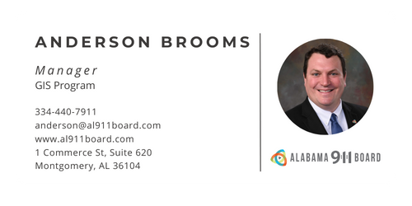

Slide 3
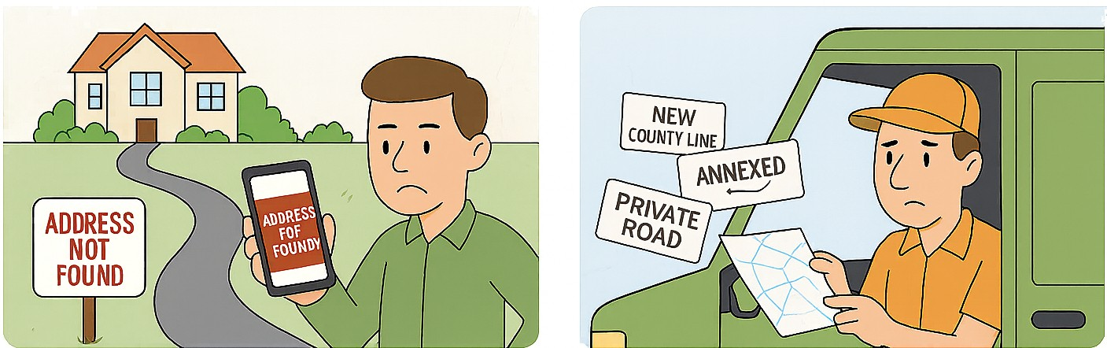

When your pizza or your package can’t find you…..It’s annoying
When your location information isn’t correct in the GIS, it’s a delivery problem
– and a data problem
Wrong street names, missing addresses, and out of date GIS information create frustration for delivery drivers, pizza delivery, homeowners and businesses. Those same issues break NG 9-1-1 workflows. Accurate GIS data is the backbone of how emergency calls are routed and responders are guided to incident locations.
GIS Data Matters: “Close Enough” is not good enough for Next Generation 9-1-1
Notes:
Everyone’s data has been onboarded into VEP. Seven ECDs never attended; we’re moving on. Training

Slide 4
Introduction
The NENA NG9-1-1 GIS Data Model defines the layers and the schema. At minimum, Road Centerlines, Address Points and PSAP Boundaries are required.
The NENA i3 specification requires the Emergency Call Routing Function (ECRF) to use GIS data to determine which PSAP to route the emergency call to.
The Location to Service Translation (LoST) protocol defined in RFC 5222 is used to query the ECRF with the location of the caller. It takes the location information (civic or geodetic) in a PIDF-LO record, compares it to GIS data, and identifies the appropriate PSAP to route the call to.
Notes:
7 Districts did not participate in boundary discussions. Currently have 2,531 Gap and Overlap anomalies in Area 1
Fayette
Gardendale
Irondale
Lamar
Marion
Pickens
Tarrant
We will adjust boundaries on their behalf and work through anomalies with their neighbors.

Slide 5
Provisioning GIS Data into the ECRF and LVF
GIS data is provisioned to the ECRF and the LVF through the Spatial Interface (SI).
The SI performs Quality Control (QC) checks to ensure the GIS data meets the acceptable criteria to be published to the ECRF and LVF.
If the GIS fails the QC checks, then the errors are reported back to the GIS data provider via a Discrepancy Report.
Notes:
7 Districts did not participate in boundary discussions. Currently have 2,531 Gap and Overlap anomalies in Area 1
Fayette
Gardendale
Irondale
Lamar
Marion
Pickens
Tarrant
We will adjust boundaries on their behalf and work through anomalies with their neighbors.

Slide 6
How it Works – Wireless Calls
The first step is for the LoST server to determine if it is authoritative for the given location. It determines this by checking the location against the geodetic coverage defined in the ECRF.
Next, the server queries the appropriate boundary layer with the geodetic location and performs a point in polygon intersection function to determine the PSAP to route the call to.
In the case of two overlapping shapes, the server is configured to use the greatest area of overlap.
Notes:
7 Districts did not participate in boundary discussions. Currently have 2,531 Gap and Overlap anomalies in Area 1
Fayette
Gardendale
Irondale
Lamar
Marion
Pickens
Tarrant
We will adjust boundaries on their behalf and work through anomalies with their neighbors.

Slide 7
How it Works – Wireline Calls
The first step is for the LoST server to determine if it is authoritative for the given location. It determines this by checking the values in the query against the civic coverage defined in the ECRF.
Next, the server queries the address data to try and find a single mapping. If it cannot, it will query the roads data.
Once it finds a match to the correct attributes on the addresses or roads, it performs a point in polygon intersection function to determine the correct PSAP to route the call to.
Notes:
7 Districts did not participate in boundary discussions. Currently have 2,531 Gap and Overlap anomalies in Area 1
Fayette
Gardendale
Irondale
Lamar
Marion
Pickens
Tarrant
We will adjust boundaries on their behalf and work through anomalies with their neighbors.

Slide 8
Civic Location Validation
The GIS data is capable of providing more detailed location information than MSAG data.
GIS data conforming the CLDXF standard has 29 fields available for location information attributes. MSAG has 9.
MSAG can get you to a street. GIS can get you to the correct building, floor, unit, room or seat of a specific address point.
Notes:
7 Districts did not participate in boundary discussions. Currently have 2,531 Gap and Overlap anomalies in Area 1
Fayette
Gardendale
Irondale
Lamar
Marion
Pickens
Tarrant
We will adjust boundaries on their behalf and work through anomalies with their neighbors.

Slide 9
Location Validation Function
This functional element uses your GIS data to validate address locations prior to a 911 call
Carriers will utilize the LVF to verify civic address locations are valid for routing and dispatch
SiteStructureAddressPoint
Yes
Is Valid?
No
Success
RoadCenterLine
Main Datasets used by the LVF:
Address Points
Road Centerlines
Is Valid?
No
Yes
Success
Error

Slide 10
Emergency Call Routing Function
This functional element is the primary location-based routing element
Both the LVF and ECRF use the SAME source of authoritative GIS data
Point-in-Polygon
Wireless Call
X,Y Coordinates
Wireline Call
Civic Address
SiteStructureAddressPoint
Point in PSAP/Service Boundary Polygon
Yes
Successful Match
No
Main Datasets used by the ECRF:
PSAP Boundary
Service Boundaries
Address Points
Road Centerlines
Point in PSAP/Service Boundary Polygon
Geocode RoadCenterLine
Point in PSAP/Service Boundary Polygon

Slide 11






How it Works
123 Main St
If the location information is a civic address, request ECRF use GIS: SSAP/RCL to translate to a geolocation
911 call comes into the network as a SIP invite with PIDF-LO
ECRF returns the serviceURI to the ESRP to complete the call routing(with possible policy routing rules affecting said routing)
ESRP asks ECRF for routing for that PIDF-LO
ECRF then uses point in polygon
(X,Y provided in call or geolocation found using SSAP/RCL)
to find the serviceURI of the request’s service (serviceURN), using the appropriate service layer(PSAP, Fire, Law, EMS.)
Call is routed to the correct PSAP

Slide 12
From Data to Impact: Why Remediation Matters
Every validation and edit improves how 911 calls are routed.
Each corrected road name, address point, or boundary ensures calls reach the right PSAP the first time.
Accurate GIS data isn’t just a technical deliverable — it’s the foundation for life-saving accuracy.
As we close the loop between local datasets and statewide core services, we’re turning GIS remediation into public safety accountability.
Notes:
Everyone’s data has been onboarded into VEP. Seven ECDs never attended; we’re moving on. Training

Slide 13
Statewide GIS Data Remediation Project
INdigitial provided minimum GIS data requirements for provisioning to core services
DATAMARK Outlined 26 VEP validations over 4 key metrics corresponding to the data requirements
Ongoing project to remediate GIS data to the requirements
Requirements are not the entirety of the NENA i3 Standard for Next Generation 9-1-1
Collaborative effort between the Alabama 9-1-1 Board, INdigital, and DATAMARK.
Focused on remediating Address Points, Road Centerlines, PSAP, and Emergency Service Boundaries.
Uses DATAMARK’s VEP software to identify and correct data anomalies.
Notes:
Everyone’s data has been onboarded into VEP. Seven ECDs never attended; we’re moving on. Training

Slide 14
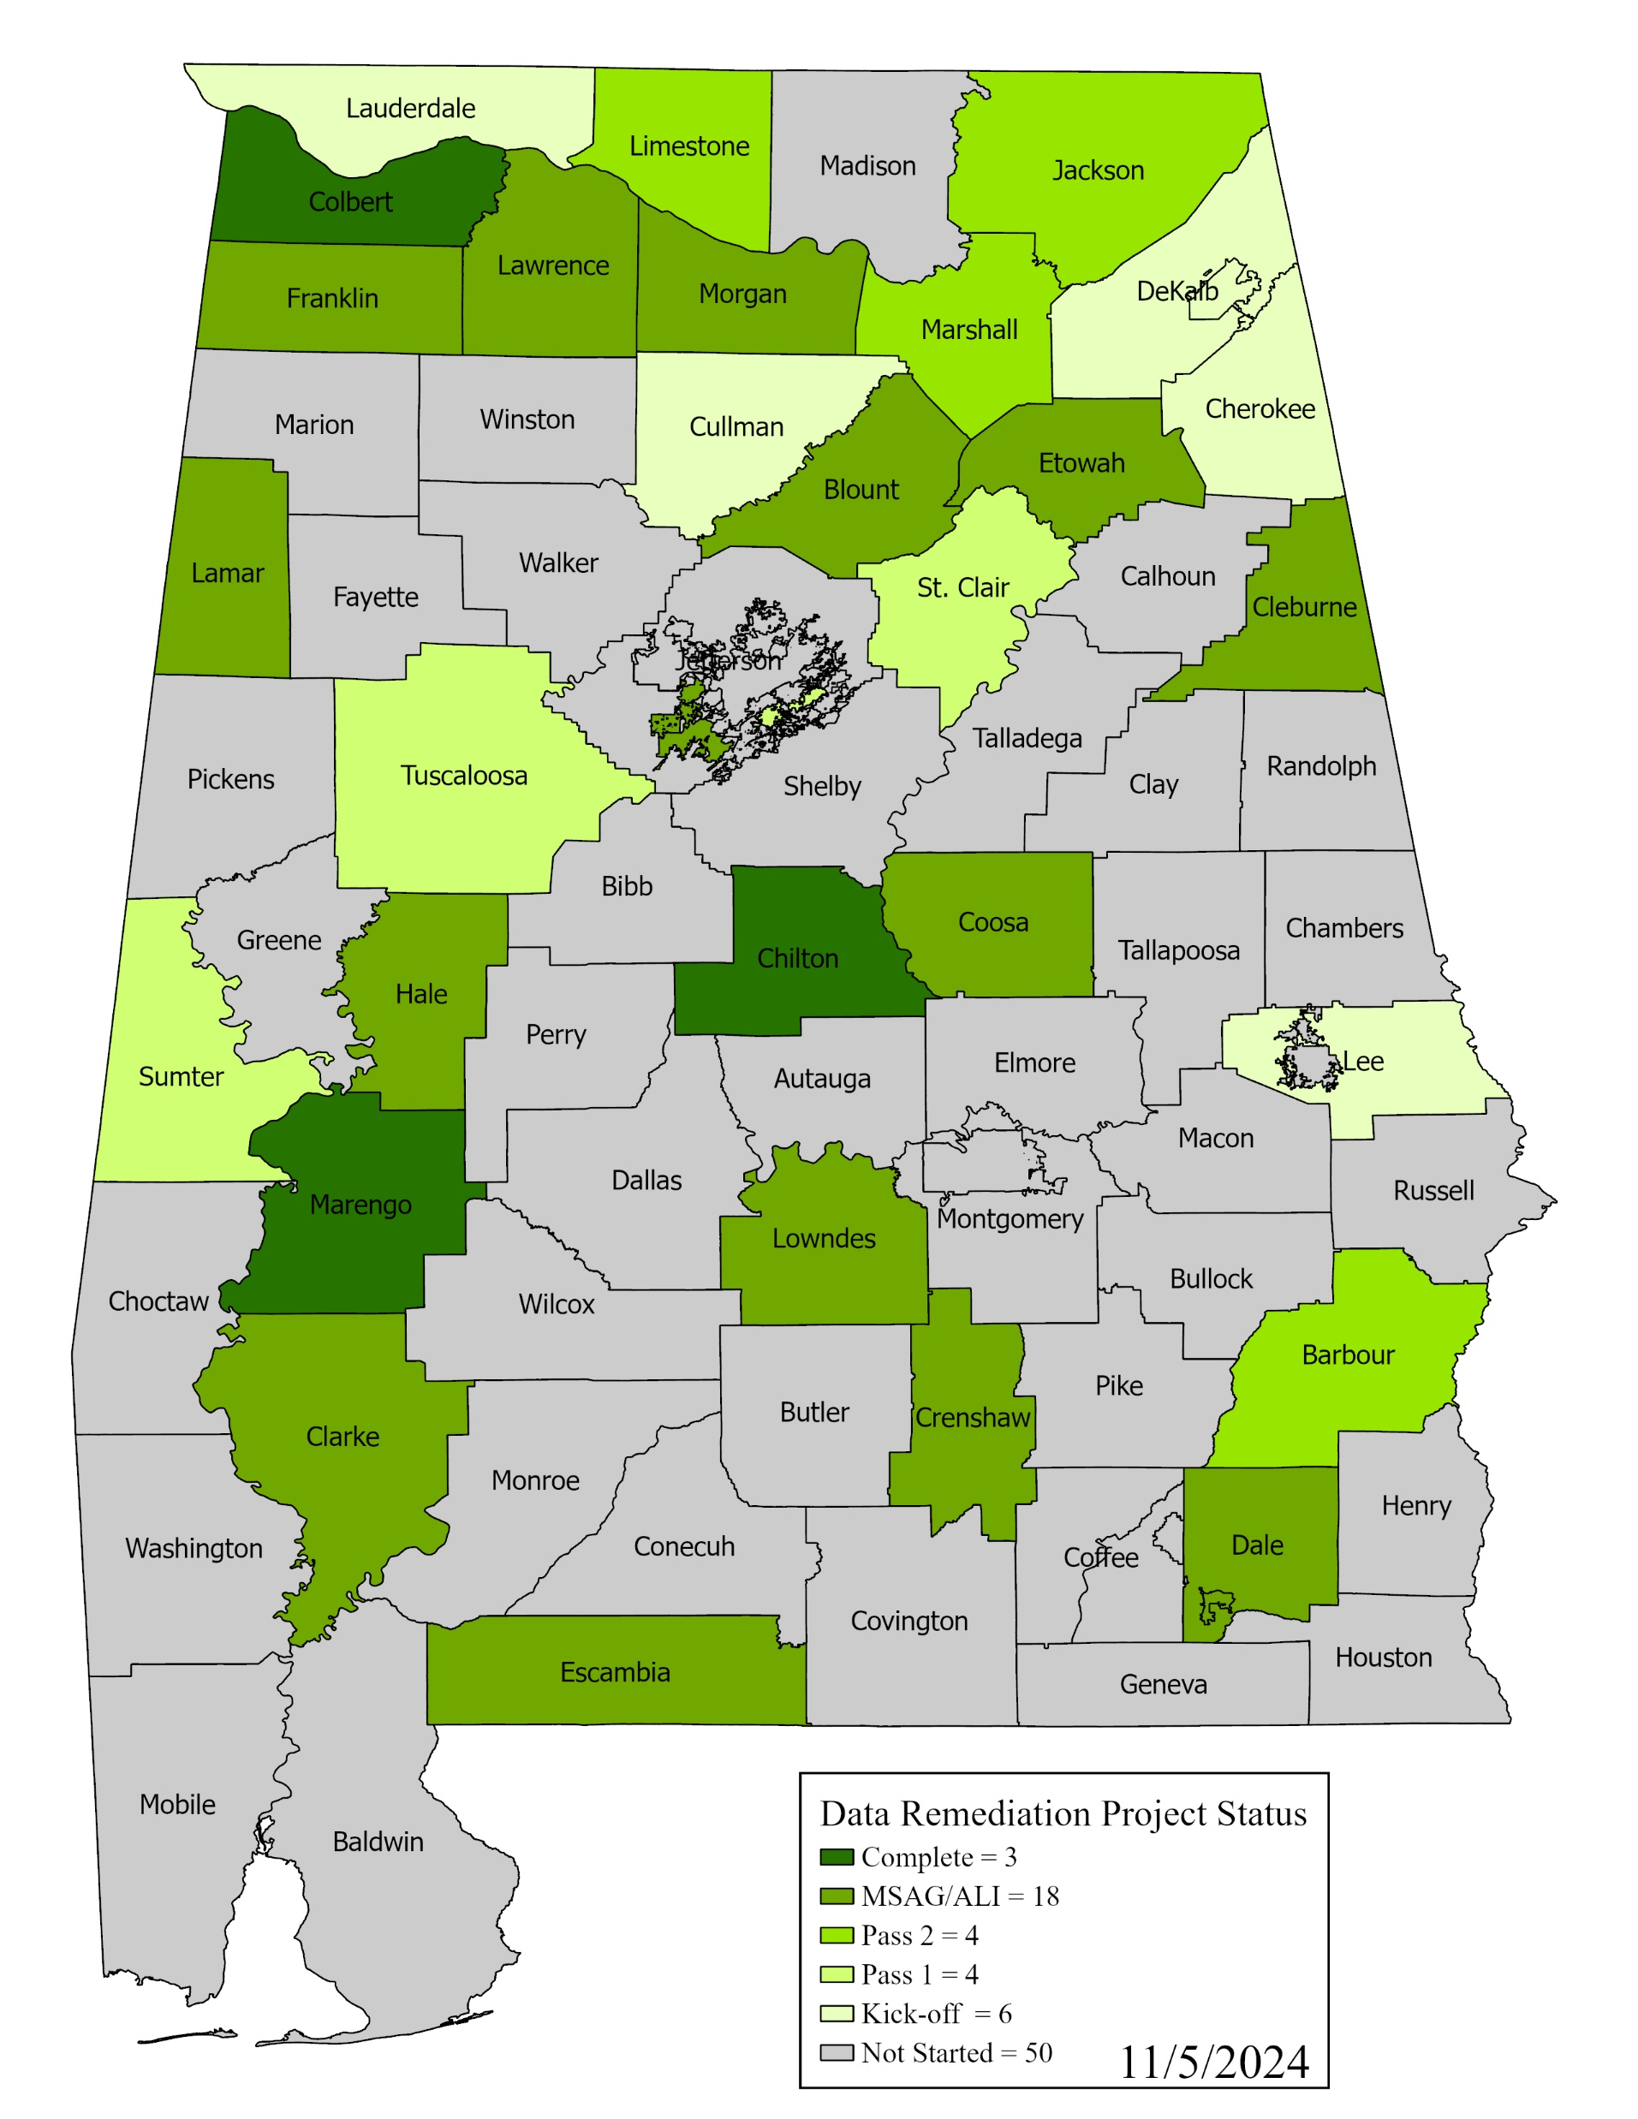
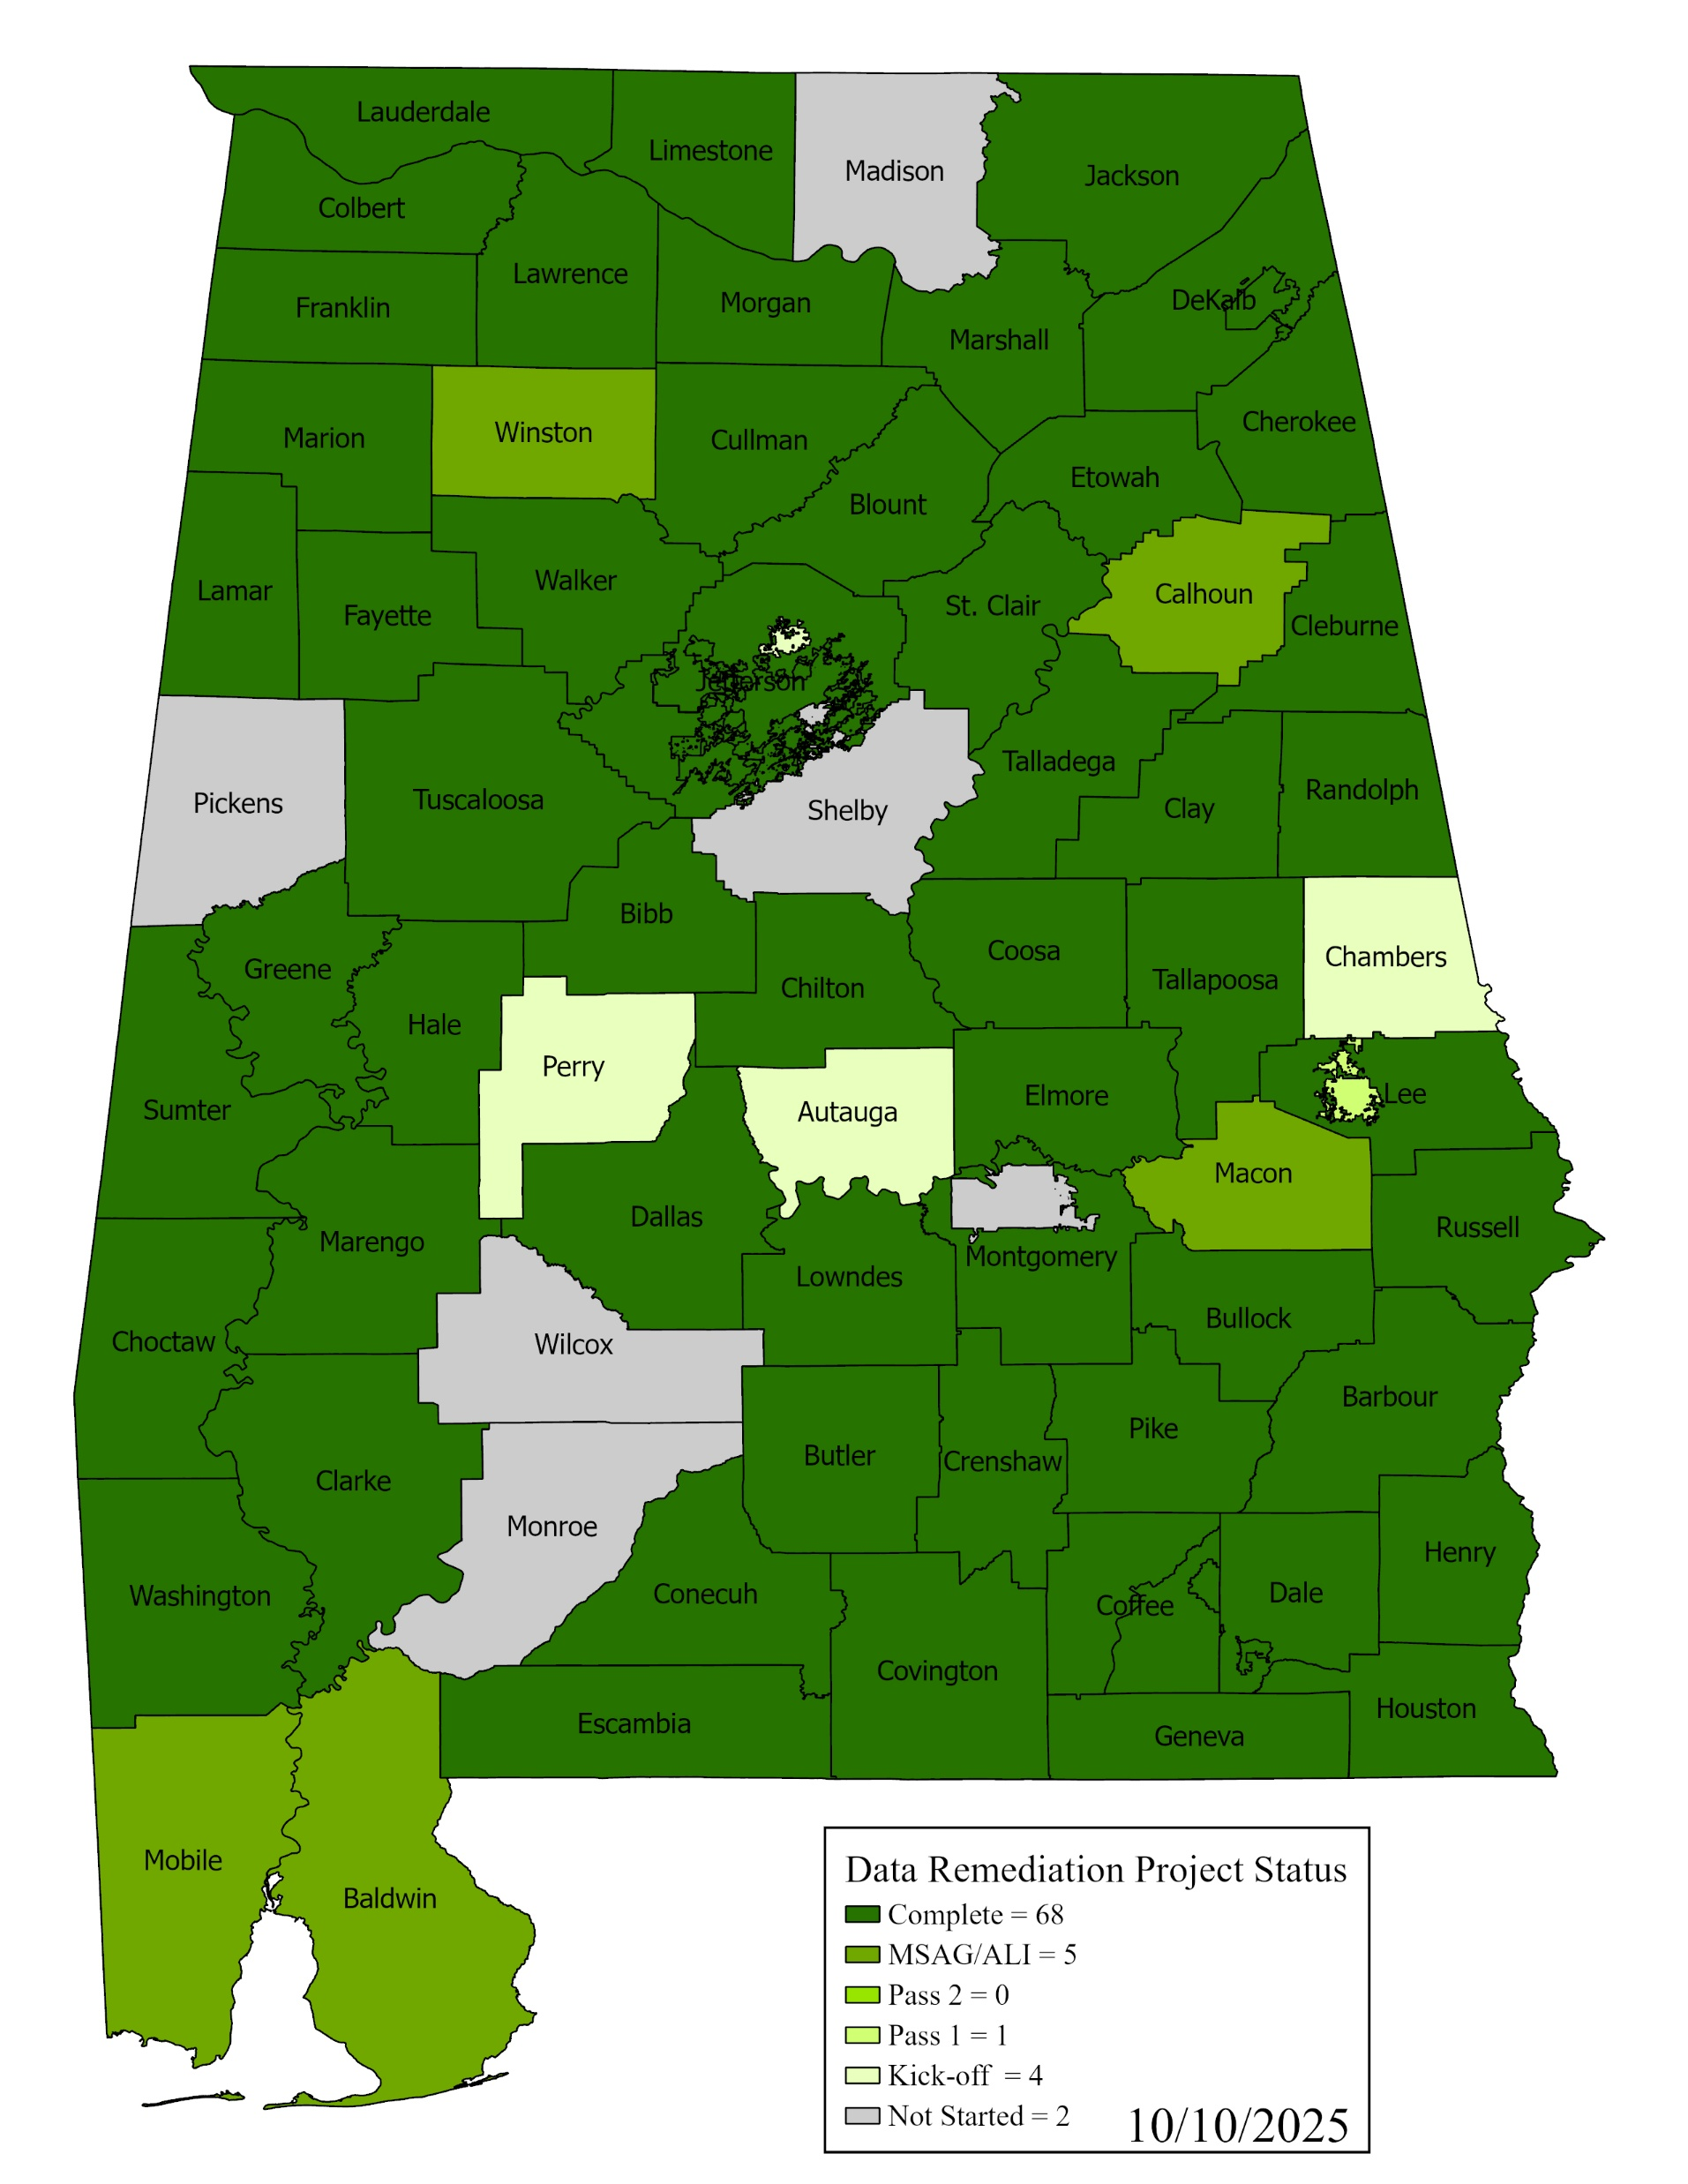
Statewide GIS Data
Remediation Project
Status by ECD
Notes:
Everyone’s data has been onboarded into VEP. Seven ECDs never attended; we’re moving on. Training

Slide 15
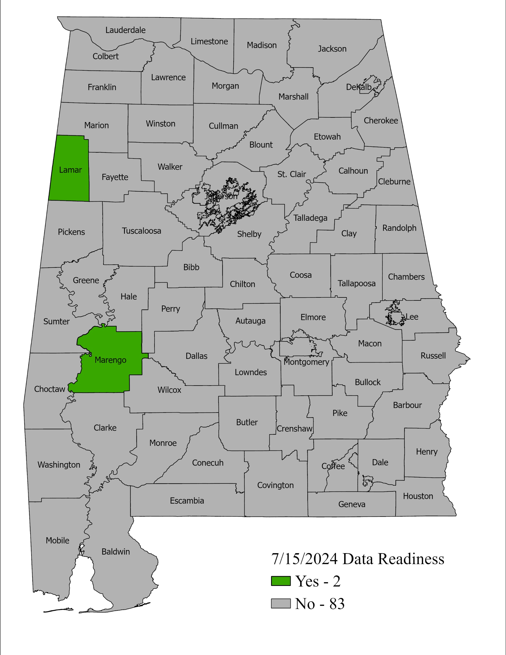
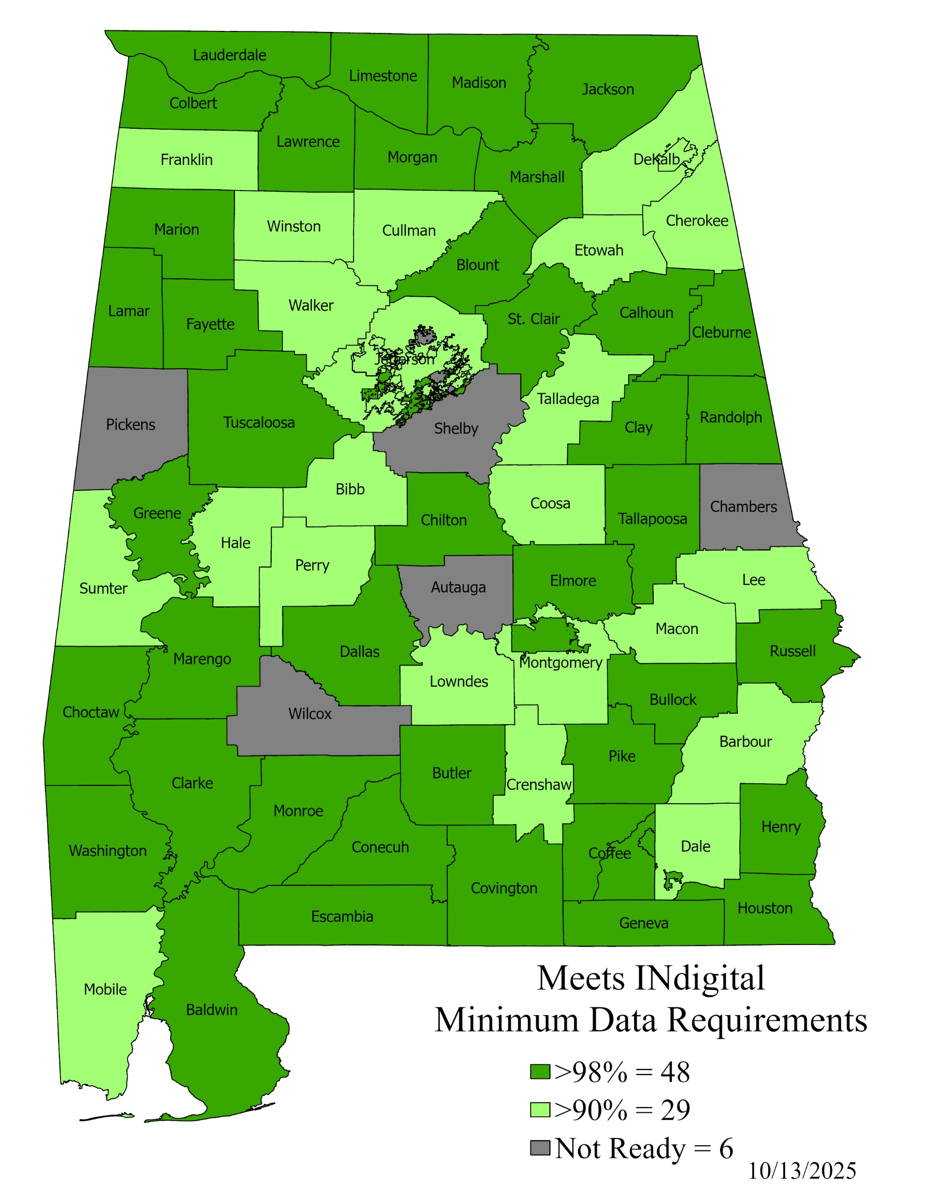
Notes:
Everyone’s data has been onboarded into VEP. Seven ECDs never attended; we’re moving on. Training

Slide 16
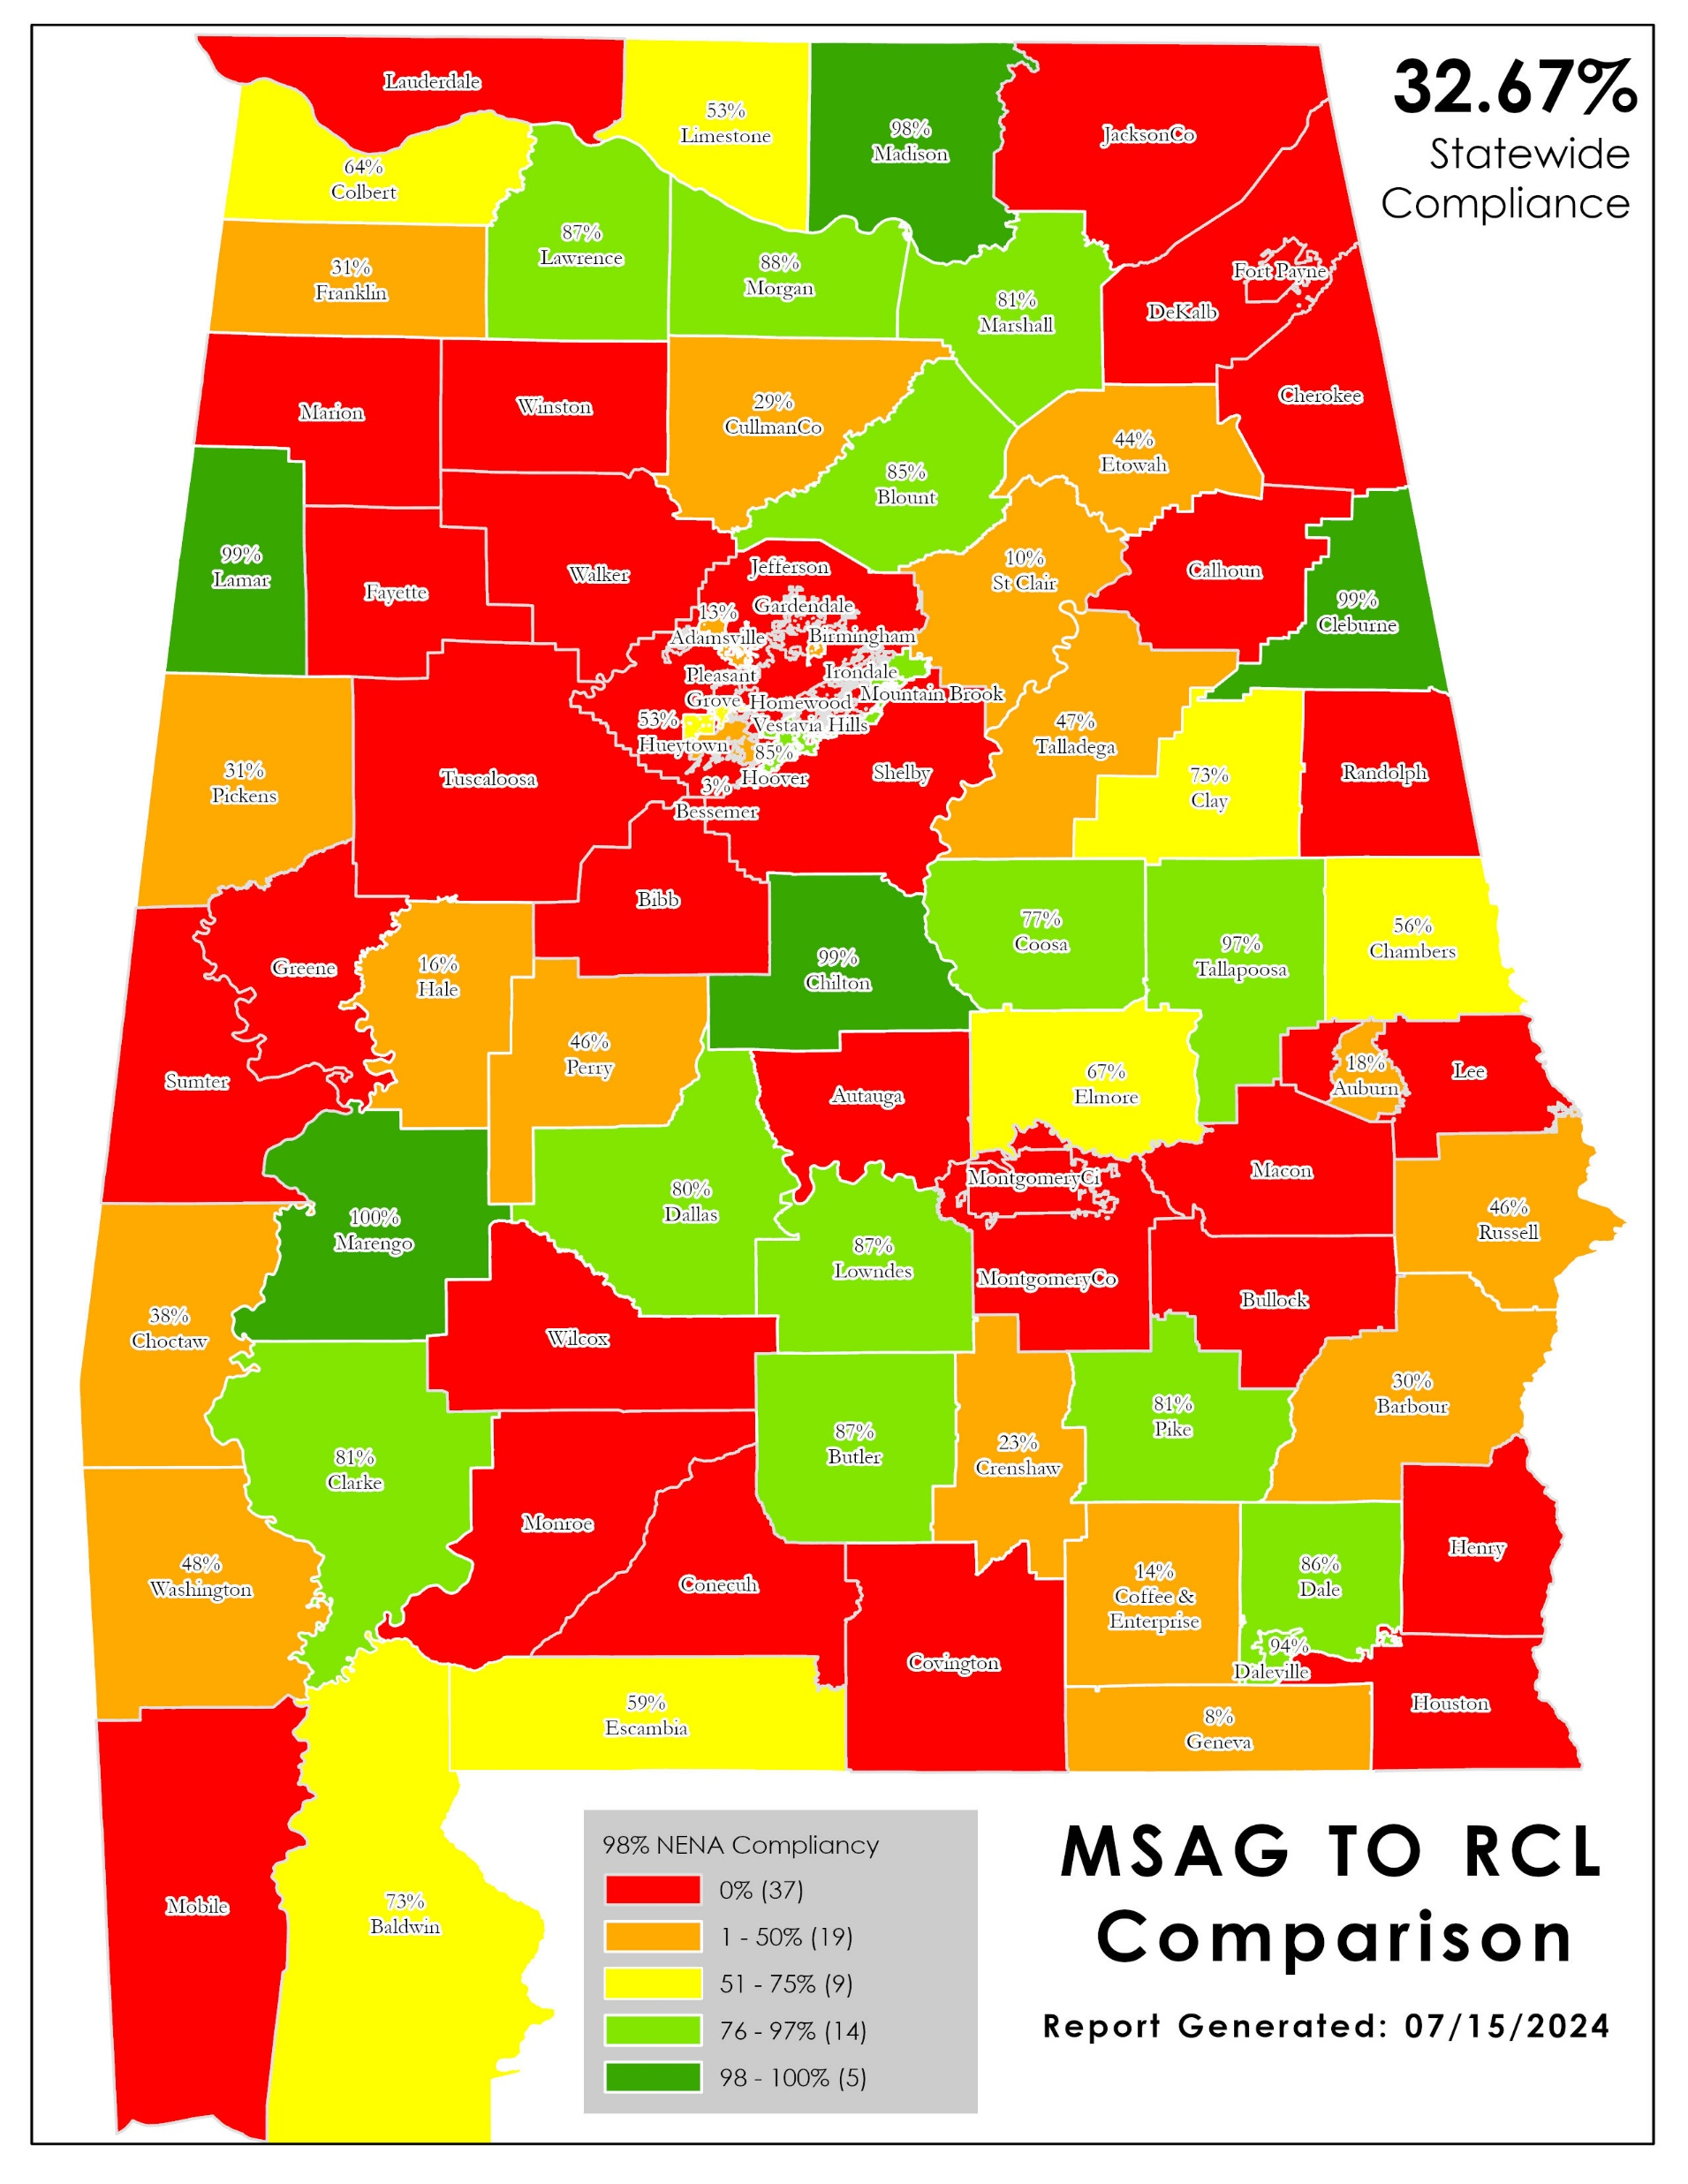
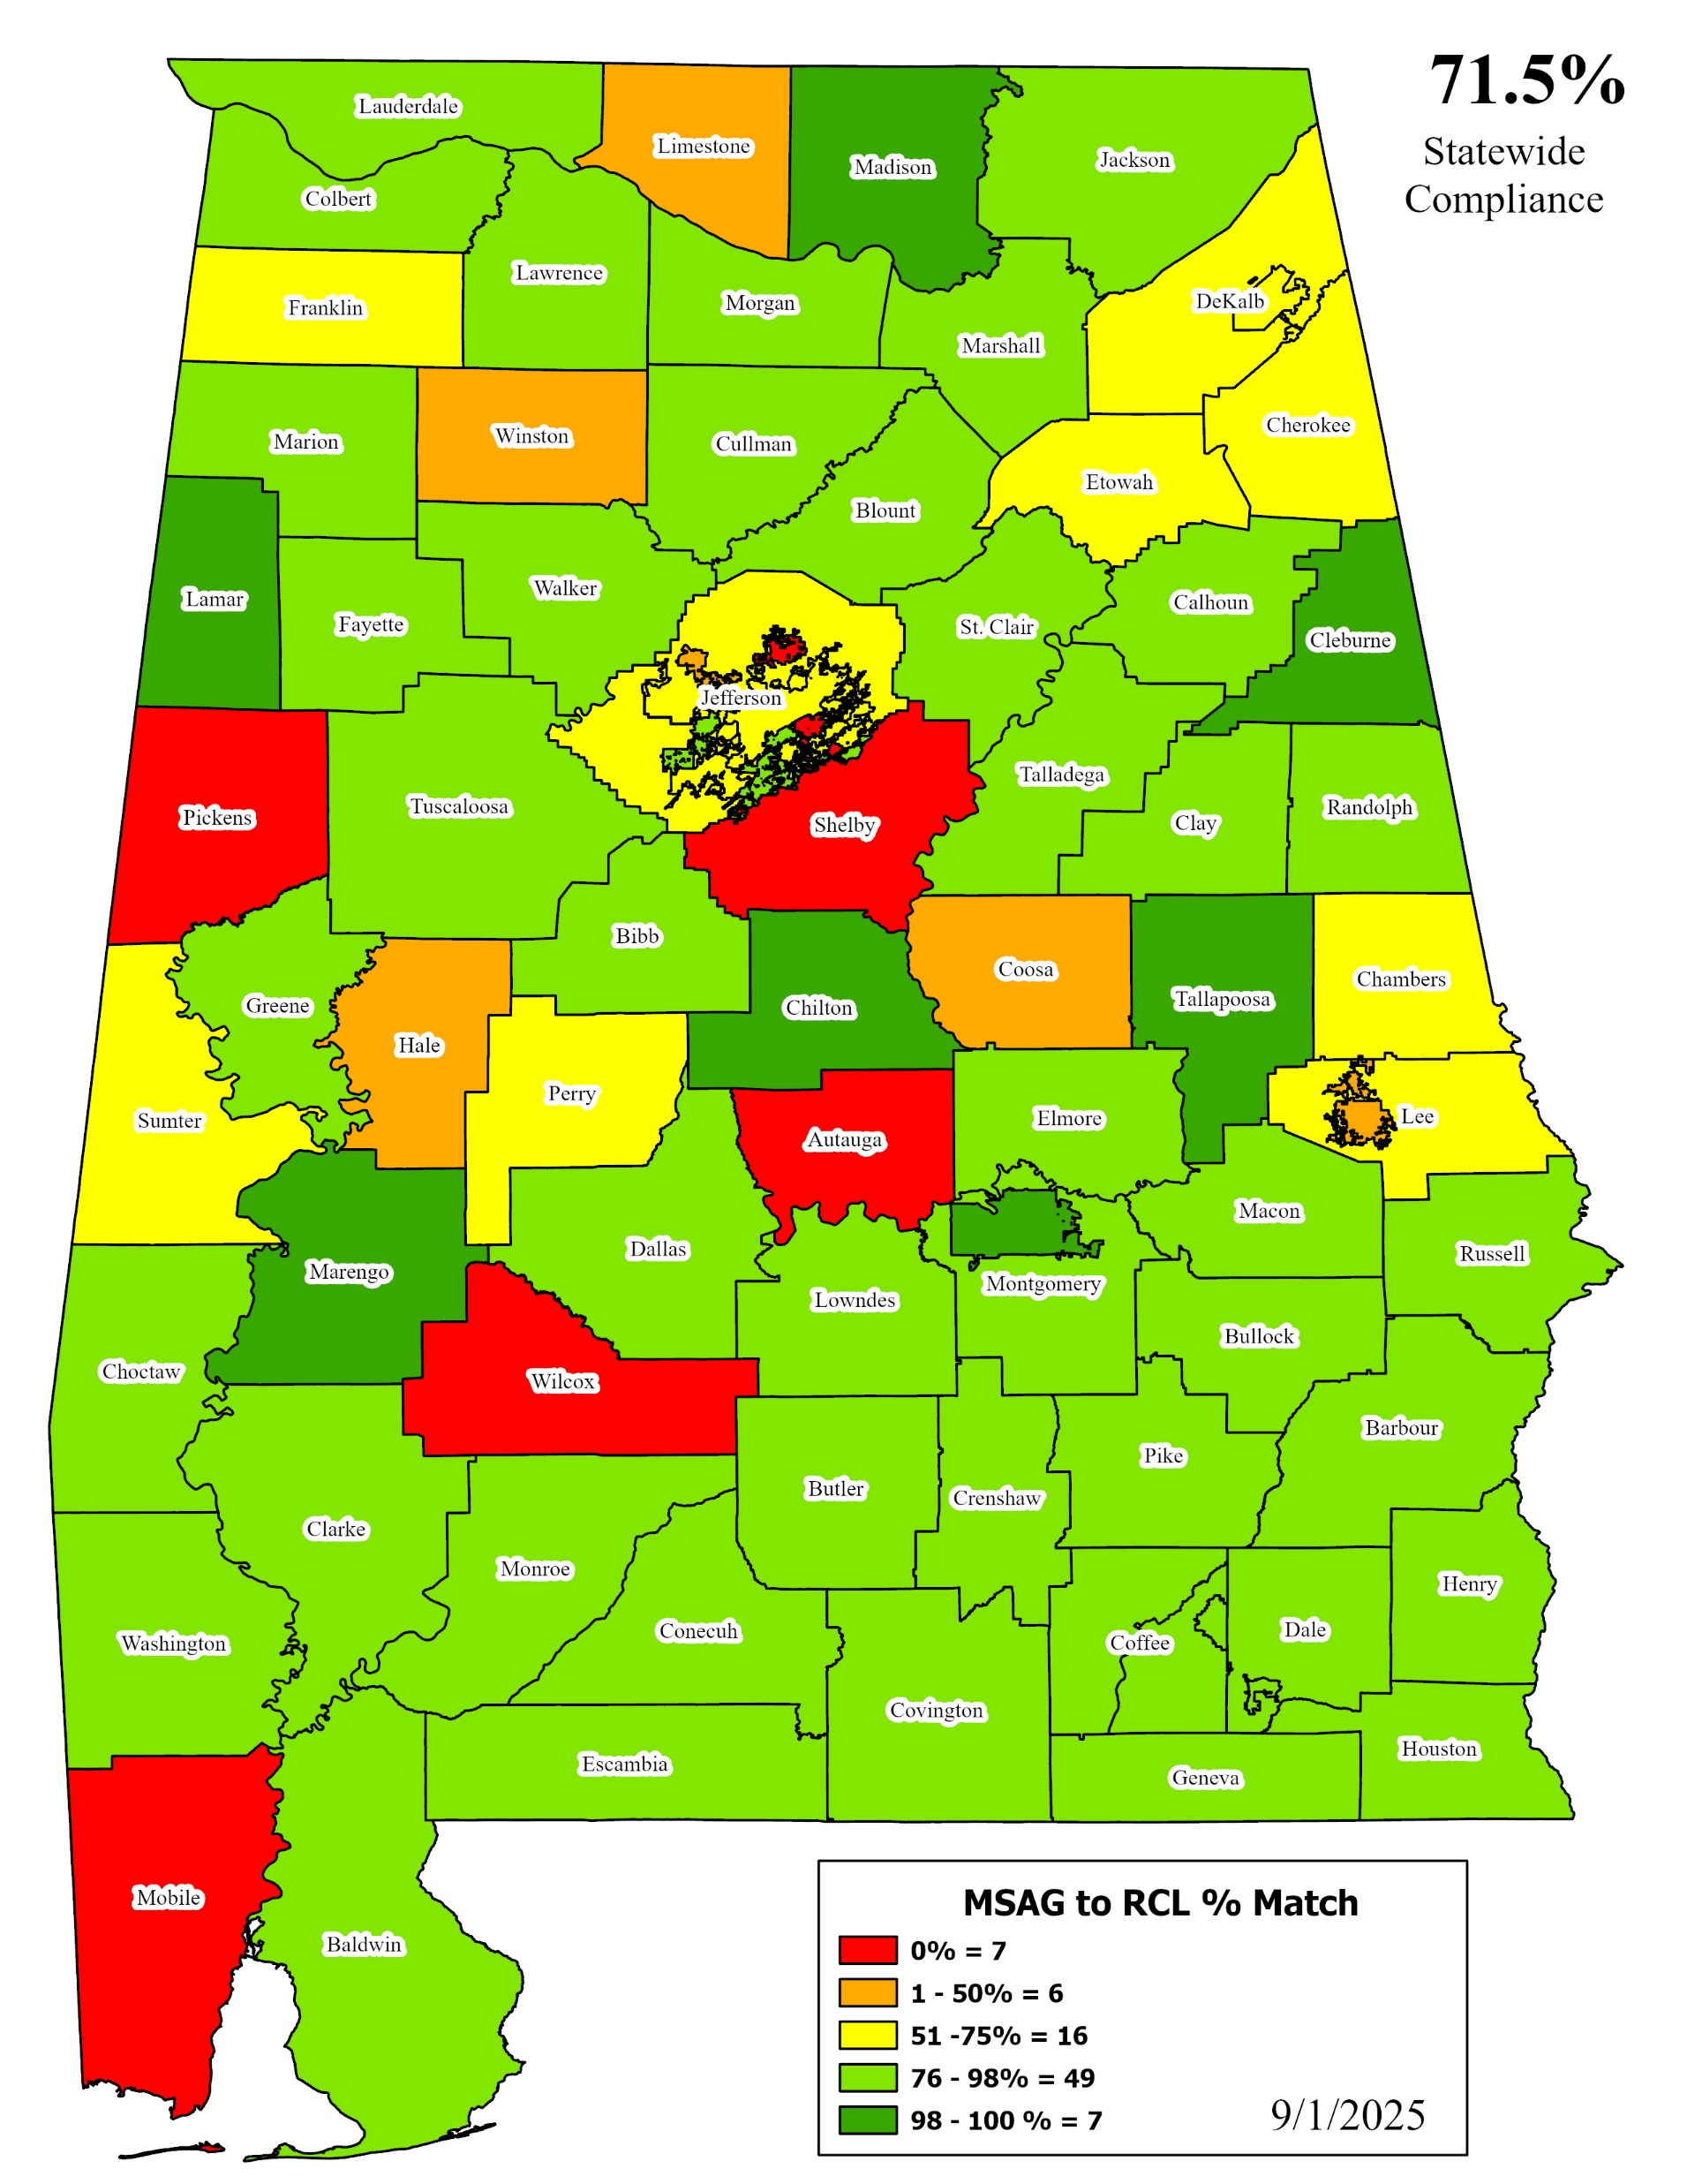
Notes:
7 Districts did not participate in boundary discussions. Currently have 2,531 Gap and Overlap anomalies in Area 1
Fayette
Gardendale
Irondale
Lamar
Marion
Pickens
Tarrant
We will adjust boundaries on their behalf and work through anomalies with their neighbors.

Slide 17
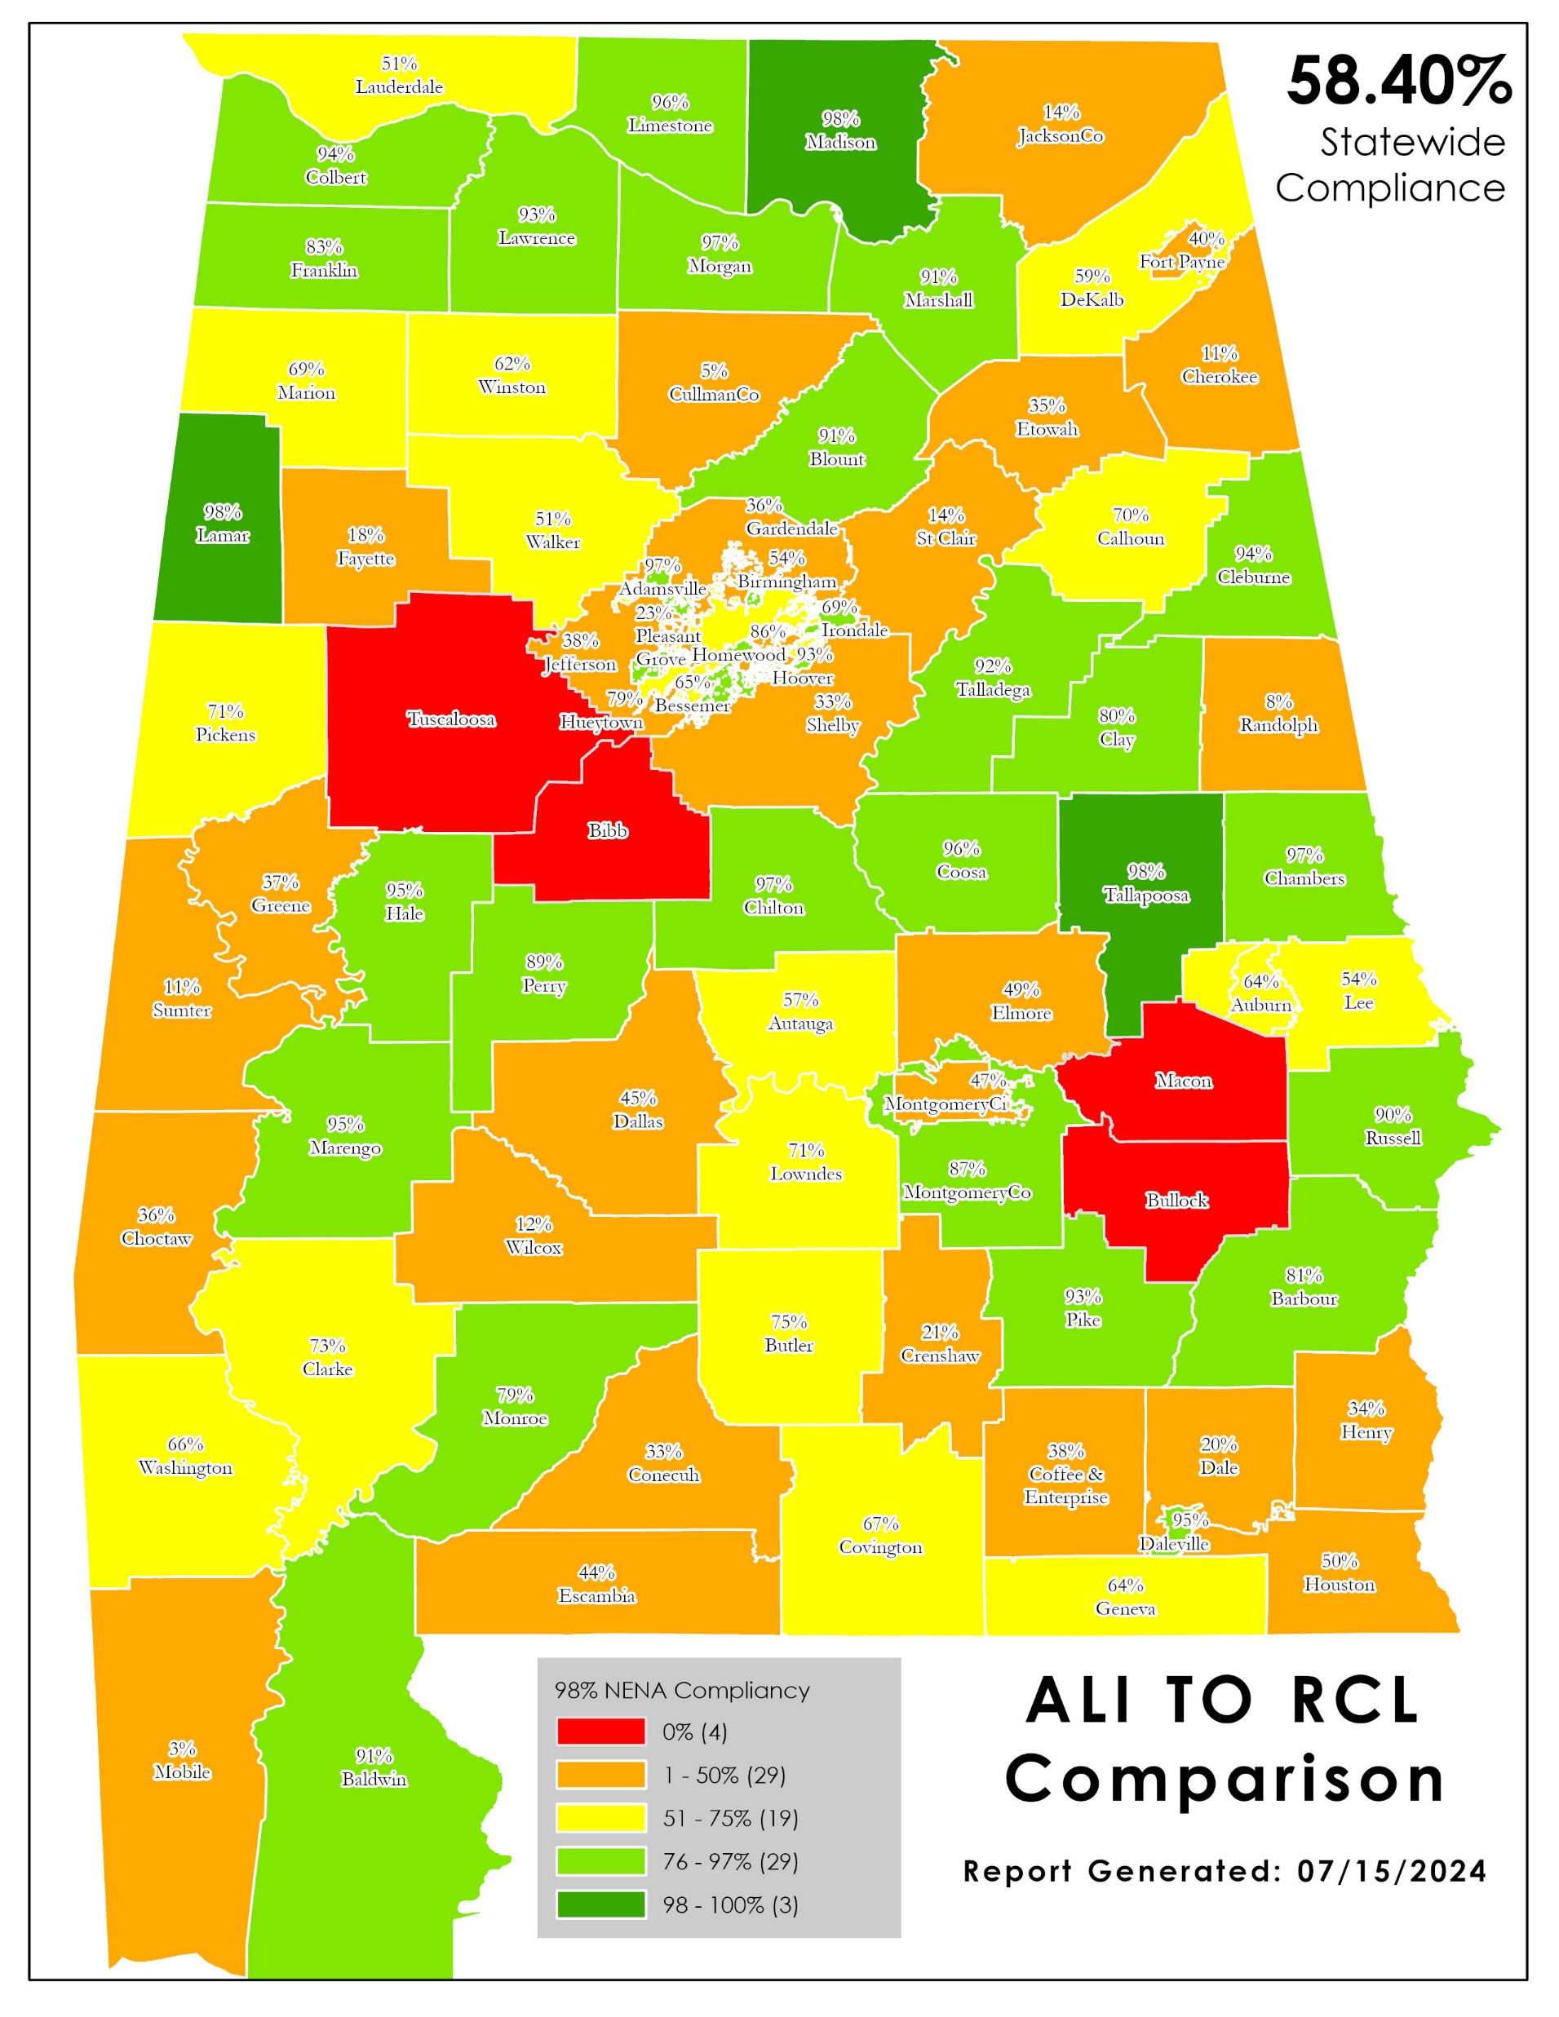
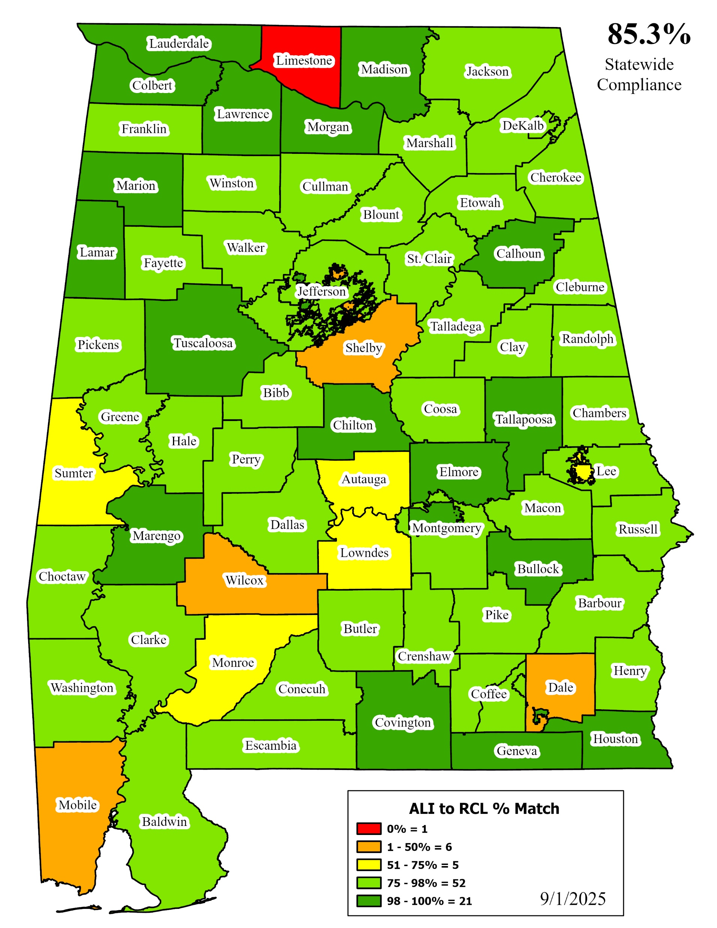
Notes:
7 Districts did not participate in boundary discussions. Currently have 2,531 Gap and Overlap anomalies in Area 1
Fayette
Gardendale
Irondale
Lamar
Marion
Pickens
Tarrant
We will adjust boundaries on their behalf and work through anomalies with their neighbors.

Slide 18
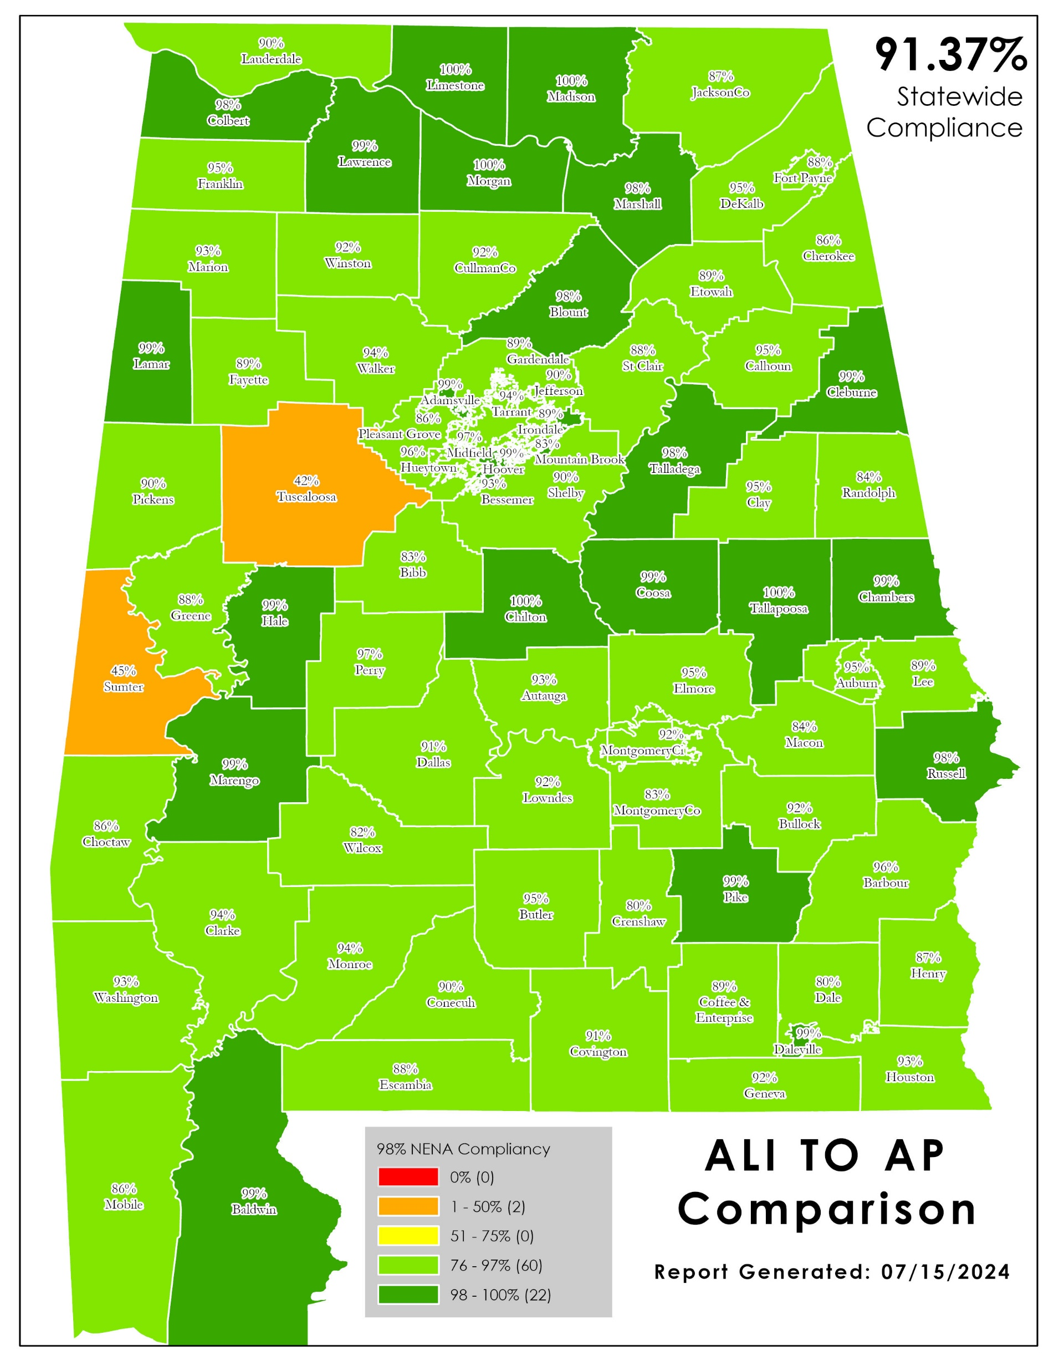
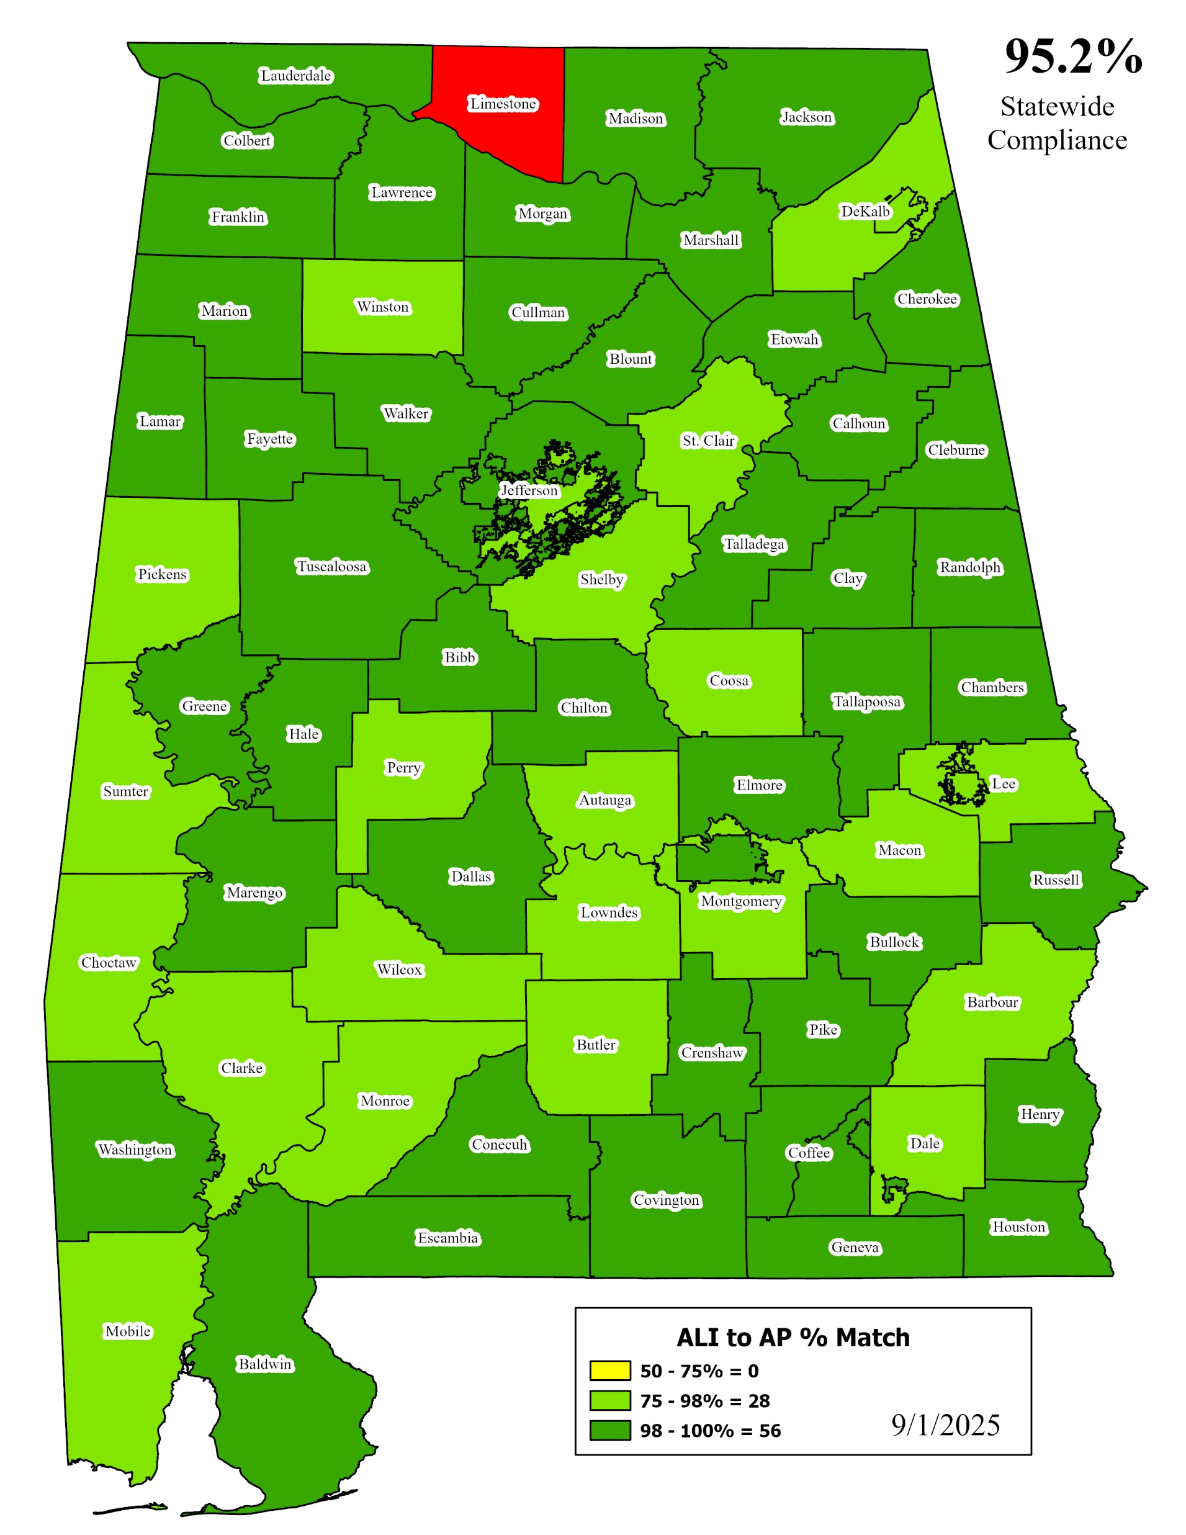
Notes:
7 Districts did not participate in boundary discussions. Currently have 2,531 Gap and Overlap anomalies in Area 1
Fayette
Gardendale
Irondale
Lamar
Marion
Pickens
Tarrant
We will adjust boundaries on their behalf and work through anomalies with their neighbors.

Slide 19
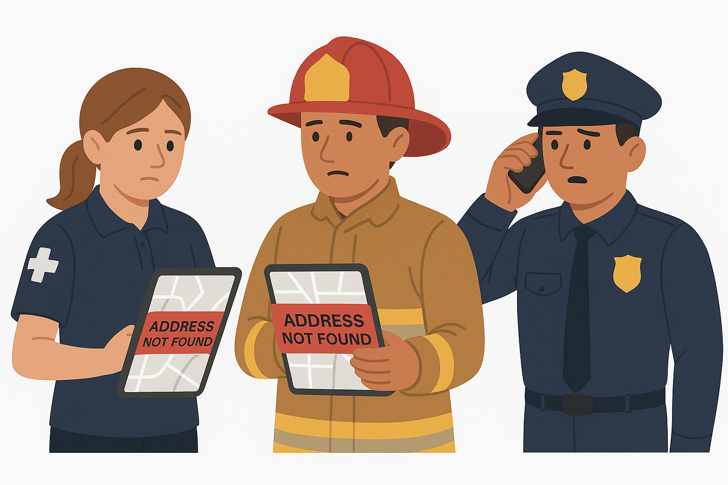
It’s never fun when your delivery driver can’t find your home…..
.…but imagine if a first responder couldn’t find you in an emergency.
Accurate address and road centerline GIS data are not just about getting deliveries to our homes – they save lives. Next Generation
9-1-1 depends on precise GIS data so emergency calls are delivered to the correct PSAP – the first time – and first responders reach the correct location. When first responders can’t find the location of an address, the same issues that delay home deliveries become critical to saving lives.
GIS Data Matters: “Close Enough” is not good enough for Next Generation 9-1-1
Notes:
7 Districts did not participate in boundary discussions. Currently have 2,531 Gap and Overlap anomalies in Area 1
Fayette
Gardendale
Irondale
Lamar
Marion
Pickens
Tarrant
We will adjust boundaries on their behalf and work through anomalies with their neighbors.

Slide 20
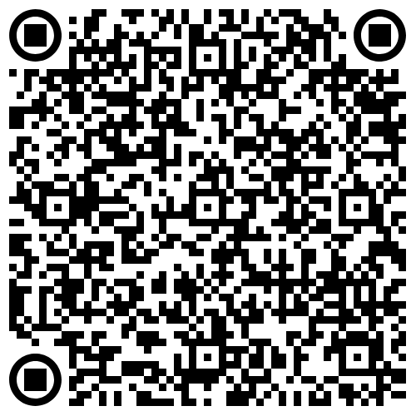
GIS and NG 9-1-1 Call Routing
2025 AL-NENA Gulf Coast Conference

